Slide 1
CS 513 Knowledge Discovery and Data Mining
HR Analytics – Likeliness of a Data Scientist to switch job

Slide 2




Team Members
Yash Jain
CWID: 20016075
Jayaram Kumarapu
CWID: 20011914
Daksh Pruthi
CWID: 20011076
Gabriel Souza
CWID: 20011924

Slide 3
Problem Statement
The process of hiring good talent is complicated and involves cost-benefit analysis at multiple levels.
A company who is looking to hire Data Scientists wants to make the process quick, less labor intensive and cost-effective.
The company started a training program and collected the data of all the people who participated in the program.
By using predictive modeling, we are classifying the profiles of the candidates to determine their likeliness to switch jobs.
https://www.kaggle.com/datasets/arashnic/hr-analytics-job-change-of-data-scientists
Notes:
Every company evaluates their applicants before hiring them thoroughly. This process is complicated and involves cost benefit analysis at multiple levels. Our project is targeting the willingness of a candidate to join the company. This dataset is provided by a company that hosted a bootcamp of sorts and wants to analyze whether the applicants to the bootcamp would be willing to join them and leave their current jobs. Doing this would reduce their waste of resources on candidates who would have a very low chance of joining the company.

Slide 4
Data Set Explanation
The Data set (train.csv) has 19K Rows and 14 Columns
The data set has the information about candidate’s demographics, relevant experience and the time they spent to complete the training
The task is to classify the profile of the candidate (0 – Not looking for job change, 1 – Looking for a job change)
Notes:
The dataset contains 14 columns including the target column with 19 thousand samples. The dataset involves features that provide information about candidates demographics, their relevant experience, the time they spent to complete the training, etc. Our task is to classify whether the candidate is willing to join the company and leave their current job or not.

Slide 5
Understanding Data Set
enrollee_id: Unique ID for candidate
city: City code
city_development_index : Development index of the city (scaled)
gender: Gender of candidate
relevent_experience: Relevant experience of candidate
enrolled_university: Type of University course enrolled if any
education_level: Education level of candidate
major_discipline: Education major discipline of candidate
experience: Candidate total experience in years
company_size: No of employees in current employer's company
company_type : Type of current employer
lastnewjob: Difference in years between previous job and current job
training_hours: training hours completed
target: 0 – Not looking for job change, 1 – Looking for a job change (binary classification)
Notes:
As mentioned earlier, we have 13 features and they can be seen on this slide. The features shed light on the candidates demographics like their city, their gender etc. They also give information about their education and current job.

Slide 6
Label Encoding and Imputing missing values
Features | Type of Data | Missing Percentage
enrolle_id | Numerical | 0
city | Categorical | 0
city_development_index | Numerical | 0
gender | Categorical | 23.86
relevent_experience | Categorical | 0
enrolled_university | Categorical | 1.45
education_level | Categorical | 2.44
major_discipline | Categorical | 14.65
experience | Categorical | 0.23
company_size | Categorical | 29.21
company_type | Categorical | 29.77
last_new_job | Categorical | 1.87
training_hours | Numerical | 0
We used Label Encoding on the Categorical Data. And populated the missing values using Iterative Imputer.
(Simple imputation strategies such as using the mean or median can be effective when working with univariate data, however, when working with multivariate data, advanced imputation methods such as iterative imputation led to better results)
Notes:
Our data has certain issues that need to be solved before we can start implementing models on it. The data has a large number of missing values, as we can see in the table, almost every column has missing values and some of them even have almost a third of them missing. Because of this, we cannot just simply drop the rows with missing values.
Another issue we need to tackle before solving the issue of missing values is high cardinality. Features like city and enrolled university have a large number of possible values which does not allow us to use simple imputation methods like substituting with the mean or median of the feature. Hence, we first use a label encoder to convert the categorical columns to numerical columns.
We then use an iterative imputer to impute the missing values. The working behind this imputer is, it considers the column to be filled as a target and the rest of features as the feature set and makes predictions. This works in a round robin fashion and can go for a set amount of iterations but will stop early if there is no change as per the defined tolerance value.

Slide 7
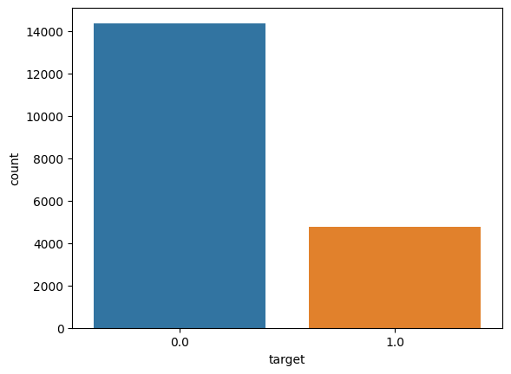
Data Balancing And Standardization
As it can be seen from the count-plot, there is imbalance in target variable which leads to model favoring target 0 cases more than target 1 cases.
SMOTE (Synthetic Minority Over Sampling Technique): instead of using copies of observations to oversample, SMOTE varies attributes of the observations to create new synthetic samples
Normalization: Standard Scaler (it makes mean as 0 and scales the data to unit variance)
Notes:
The next issue we noticed the imbalanced nature of the dataset. As we can see from this graph, there is a huge difference between the samples for target 0 as compared to target 1. For this, we use SMOTE which stands for synthetic minority over sampling technique. SMOTE is a type of data augmentation technique combined with over sampling. It takes k nearest neighbors, pick one randomly and calculate the vector that connects the two. Then multiply this vector with a random number between 0 and 1. This gives us synthetic data while making sure it is not too different from the original data.

Slide 8
Classification Algorithms
Naïve Bayes
K-Nearest Neighbour
Logistic Regression
Decision Tree
Random Forest
XG Boost
Light GBM
ANN
Notes:
These are the algorithms that we decided to implement

Slide 9
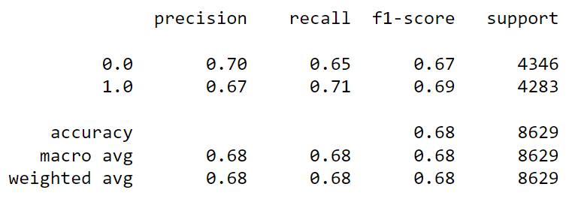
Naïve Bayes
Notes:
Naïve is a probabilistic classifier. Fast and easy to implement. Got an accuracy of 0.68 which is on a lower side because it requires the predictor variables to be independent which isn’t the case with our data.

Slide 10
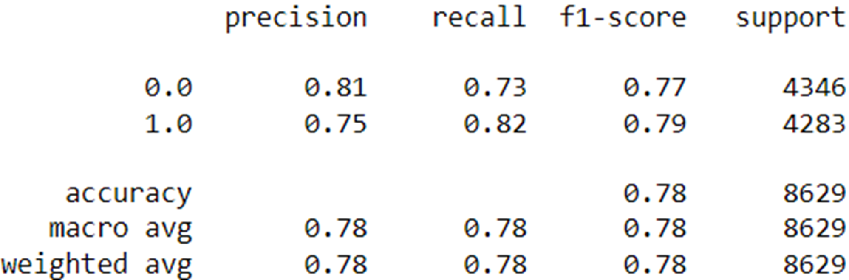
KNN (k = 5)
Notes:
Supervised and non parametric algo. It classifies data based on proximity with its k nearest neighbours. Computationally costly to implement knn when working with large datasets as it only stores the data in training phase and calculates for knn using stored data in testing phase. We went with k = 5.

Slide 11
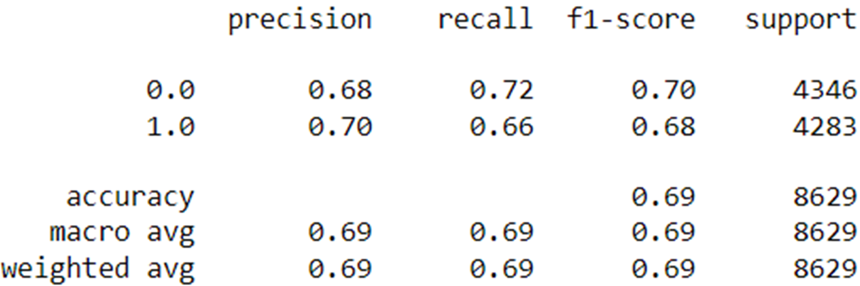
Logistic Regression

Slide 12
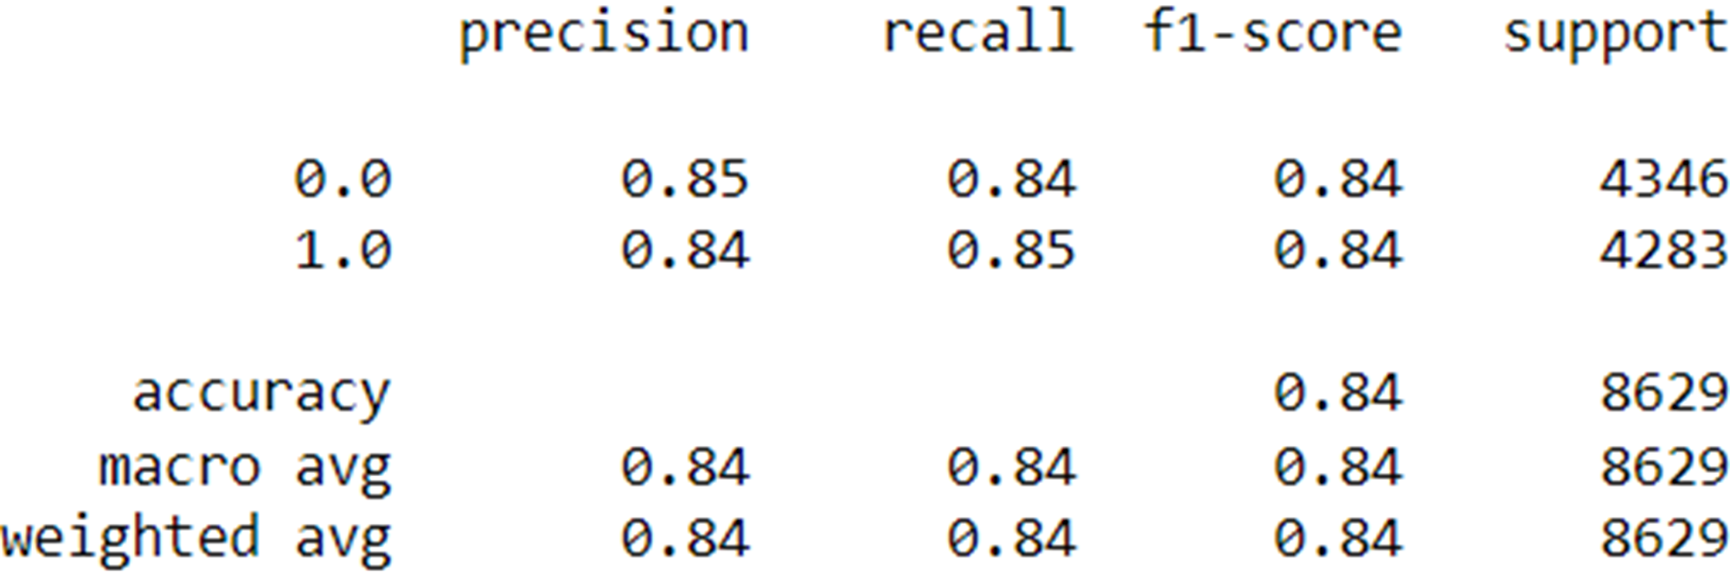
Decision Tree

Slide 13
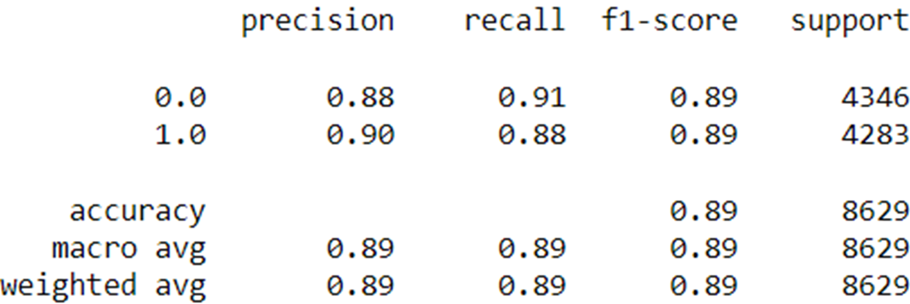
Random Forest

Slide 14
XG Boost
XG Boost is an implementation of Gradient Boosted decision trees.
In this algorithm, decision trees are created in sequential form.
Weights are assigned to all the independent variables which are then fed into the decision tree which predicts results. The weight of variables predicted wrong by the tree is increased and these variables are then fed to the second decision tree.
These individual classifiers/predictors then ensemble to give a strong and more precise model. It can work on regression, classification, ranking, and user-defined prediction problems.

Slide 15
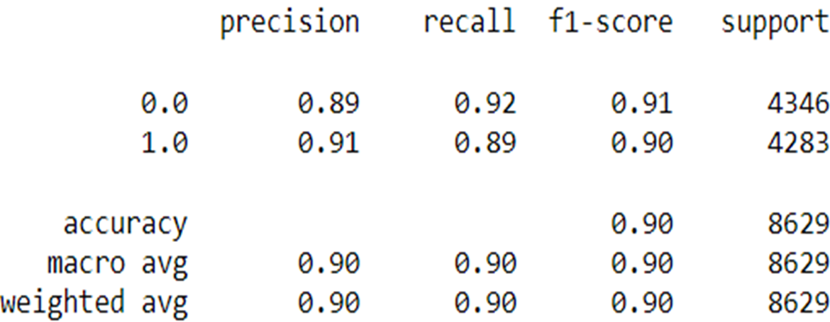
XG Boost

Slide 16
Light GBM
Light GBM is a fast, distributed, high-performance gradient boosting framework based on decision tree algorithm, used for ranking, classification and many other machine learning tasks.
Since it is based on decision tree algorithms, it splits the tree leaf wise with the best fit, whereas other boosting algorithms split the tree depth wise.
When growing on the same leaf, the Light GBM can reduce more loss than any depth-wise boosting algorithm, and hence results in much better accuracy which can rarely be achieved by any existing boosting algorithms.

Slide 17
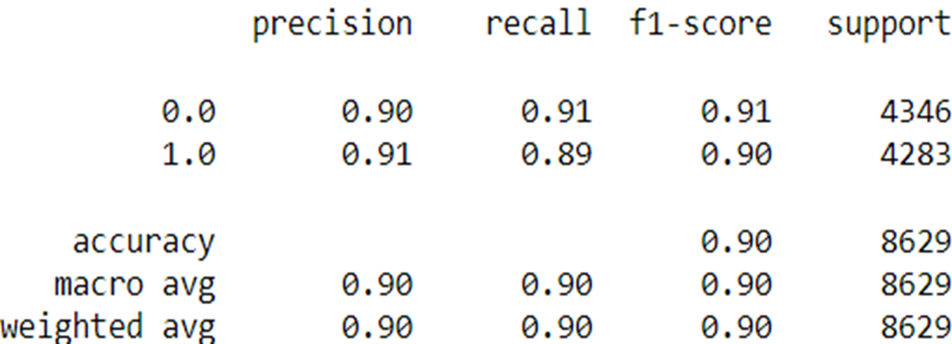
Light GBM

Slide 18
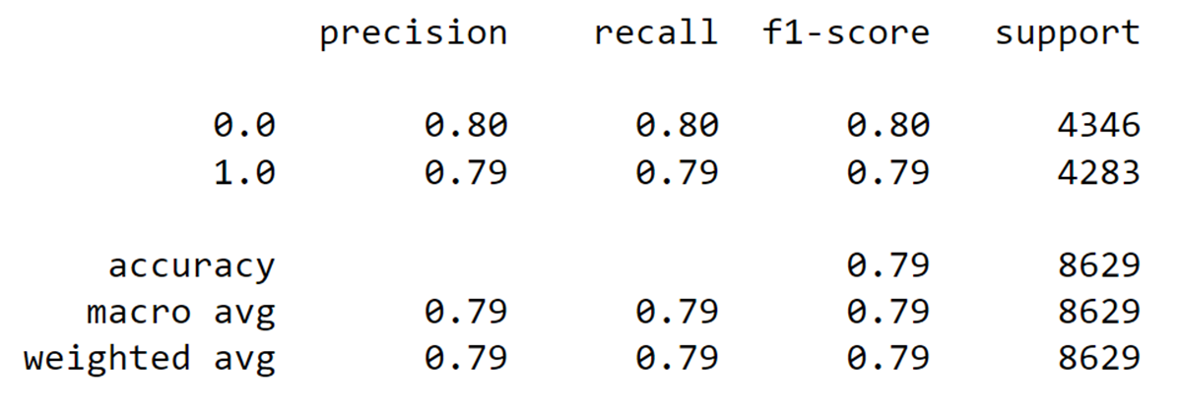
ANN

Slide 19
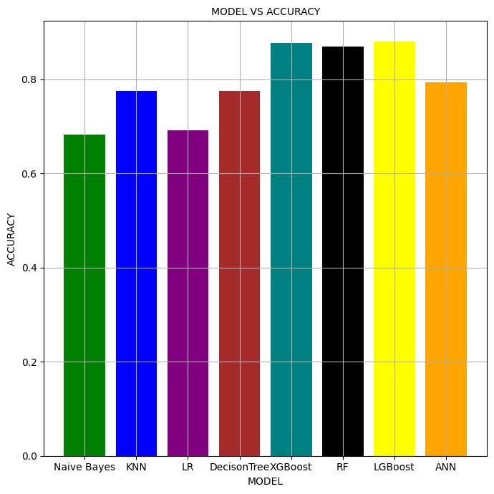
Accuracy Comparison
Notes:
Visualization of accuracy of all the models.

Slide 20
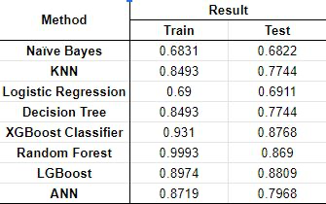
Results
Notes:
We have compiled the accuracy of all the models here for reference. This table has results for both training and testing phase. Highest accuracy – Light GBM : 88.09%. Least accuracy – Naïve Bayes: 68.22%.

Slide 21
In Conclusion
Analysis
Decision-tree based models perform better on this dataset
From the results obtained we can infer that Light GBM performs better than the rest of the models on this dataset
Naïve Bayes based model is performing with the least accuracy on this dataset

